Slide 1




Teaching Food and Nutrition in the Classroom
Developed by Registered Dietitians from
Notes:
Welcome to the recorded presentation: Teaching Food and Nutrition in the Classroom, presented in collaboration by Registered Dietitians from Chatham-Kent and Lambton Public Health.

Slide 2
Overview
Purpose
Influence of Diet Culture
What is Food Neutrality?
Why Schools?
Ways to Incorporate Food Neutral Elements
Curriculum Resources and Supports
Notes:
In this presentation, we will be discussing:
the influence of diet culture
what is food neutrality
why schools are an area to support food neutral messaging
ways to incorporate food neutral elements
and curriculum resources and supports available for educators.

Slide 3
Purpose of the Presentation
Provide guidance for educators to create supportive nutrition environments within school settings
Mitigate harm to students’ relationships with food
Provide resources for age-appropriate approaches to food and nutrition education
Notes:
The purpose of this presentation is to:
Provide food and nutrition guidance for educators and other community partners when working with children and youth.
Ensure that food and nutrition approaches mitigate harm to students’ relationship with food.
Provide resources to support food and nutrition education.
By participating in this presentation, we are hoping that participants will:
Increase their knowledge and confidence in using food neutral language in the classroom. AND
2. Increase their awareness of nutrition resources, programs and tools.

Slide 4
Land Acknowledgement
We acknowledge that the land on which we live and work is part of the ancestral land of the Ojibwe, Chippewa, Odawa, and Potawatomi peoples, referred to collectively as the Anishinaabeg. It is through the connection of the Anishinaabeg with the spirit of the land, water and air that we recognize their unique cultures, traditions, and values. Together as treaty people, we have a shared responsibility to act with respect for the environment that sustains all life, protecting the future for those generations to come.
Notes:
Before we get into the content of this presentation, we would like to acknowledge that the land on which we live and work is part of the ancestral land of the Ojibwe, Chippewa, Odawa, and Potawatomi peoples, referred to collectively as the Anishinaabeg. It is through the connection of the Anishinaabeg with the spirit of the land, water and air that we recognize their unique cultures, traditions, and values. Together as treaty people, we have a shared responsibility to act with respect for the environment that sustains all life, protecting the future for those generations to come.
Language Pronunciations:
Anishinaabeg (ah-nish-i-nah-beg)
Chippewa (chip-uh-wah)
Odawa (o-dah-wah)
Potawatomi (pot-uh-wah-tuh-mee)

Slide 5
What is Diet Culture?
Equates thinness with goodness and health
Promotes weight loss as a form of achieving status
Values certain ways of eating over others
Devalues bodies that do not fit the “image of health”
Notes:
So, what is diet culture?
We are surrounded by diet culture, which is a belief that equates thinness to health. It’s a pervasive viewpoint in North America, where there is a collective desire to be thin.
It includes myths about food and eating and creates a moral hierarchy of body shapes and sizes. Diet culture influences how we think and talk about eating, food and health. It can take the form of adhering to food rules, restrictive eating practices and feelings of shame, guilt or judgement for not following these ‘rules’ or not having the “ideal” body.
In today’s culture, diet and exercise are often promoted as ways to alter body shape and improve health. The issue with this approach is that weight loss and body shape changes are viewed as behaviors to be modified. This often becomes the main motivation for these activities, overshadowing the many other factors that influence body shape and neglecting the numerous other benefits of good nutrition and physical activity.
Our society’s focus on weight comes up in so many ways, it’s understandable that so much value, self-worth, and judgement are placed on one’s weight and body size.
For example:
On social media, people often use filters or editing apps to alter their size and appearance in photos
We may compliment someone who appears to have lost weight by saying "you look great, have you lost weight?“
And, there is a huge diet and weight loss industry trying to sell us the latest product to make us thinner.
Unfortunately, diet culture results in people in larger bodies experiencing discrimination – it oppresses people who don’t fit the diet-culture definition of health.

Slide 6

How does diet culture show up?
Weight-based Bullying
Education
Feeding Practices
Peer/Adult Influence
Media
Notes:
Diet culture shows up in the workplace, healthcare, schools and in many other areas in our society; it’s everywhere! It’s also sneaky and often hard to detect.
Diet culture shows up:
As weight-based teasing or bullying;
In education when emphasizing weight as a health promoting behaviours;
When pressuring students to eat certain foods;
Unintentionally, when adults’ pass on their attitudes around food and body image, and
In various forms of media, students are exposed to idealized bodies.
The good news is, the more you are aware of diet culture, the more you can help students develop a positive relationship with food and body.

Slide 7
Impact of Diet Culture on Kids
Promotes misinformation about food, bodies and health
Pressures to conform to thin ideal
Increases risk of eating disorder and disordered eating¹
Increases body image concerns
Leads to weight-based bullying and stigma for kids in larger bodies²
1. Tribole, Evelyn. Intuitive Eating, 4th Edition. St Martin’s Press, 2020
2. Janssen, I., Craig, W.M., Boyce, W.F. & Pickett, W. (2004). Associations Between Overweight and Obesity With Bullying Behaviours in School-Age Children. Pediatrics, 113(5), 1187-1194.
Notes:
Diet culture can:
Promote misinformation about food, bodies and health;
Place pressure on children and youth to conform to thin ideal;
Increase the risk of eating disorders and disordered eating – In fact, frequent dieting is a risk factor for eating disorders;
Increase body image concerns; when people don’t meet society’s arbitrary standards, they can feel ashamed, guilty or angry. This can contribute to negative body image and poor self-esteem, as well as mental health conditions like anxiety and depression; and
Lead to weight-based bullying and weight stigma for kids living in larger bodies.

Slide 8
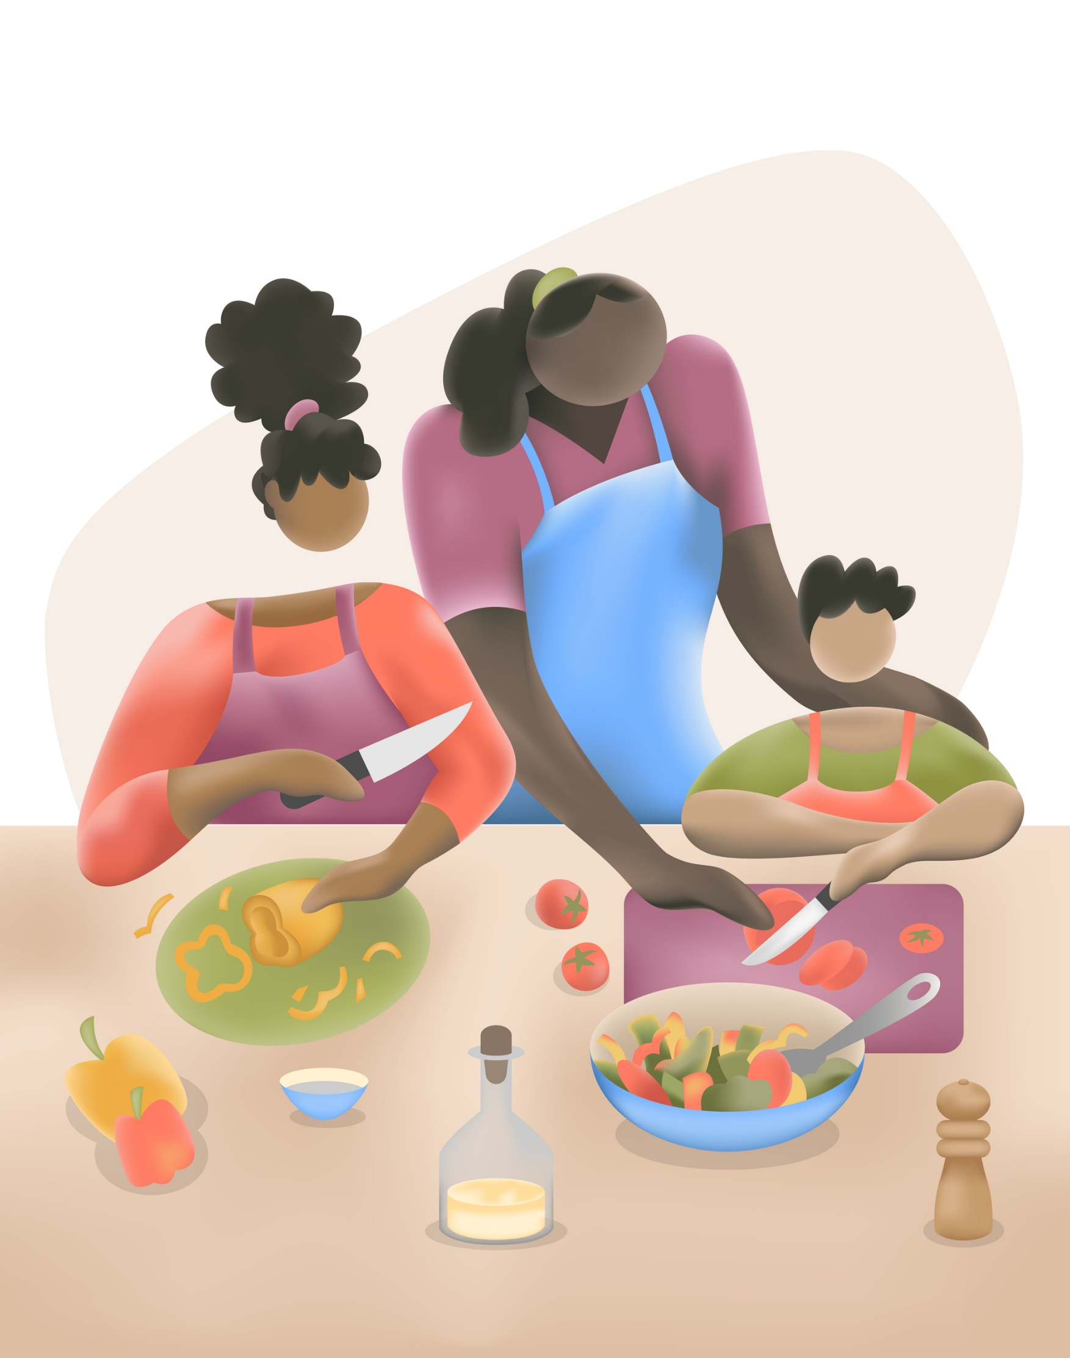
The way we talk about food matters
Food preference and choices are different for everyone
Emphasize the benefits of nutrition instead of fear-based messages
Eating and food can create feelings of shame and guilt
Some families have barriers to adopting healthy eating practices
Healthy eating is a pattern – with a lot of variation
Notes:
When talking and teaching about food, language is something most of us don’t think about. The words we use when talking about food can reflect personal beliefs and practices towards food. As professionals and educators, we know the importance of checking our bias and being careful what we say to reduce possible negative consequences.
The messages we provide related to food should consider that:
Food preferences and choices are influenced by so many things including, family traditions and feeding practices.
Often nutrition messaging focuses only on nutrients in food. We need to consider all of food’s other benefits such as enjoyment, social connections and the energy it provides us to grow, play and learn.
Eating and food can create feelings of shame and guilt. Recent stats tell us that 46% of Ontario youth in grades 7-12 report preoccupation with food and weight and body image concerns, which are known precursors to disordered eating. Given that youth are vulnerable to the development of disordered eating and body image issues, language used should be considered when planning educational activities for this age group.
Like health, multiple factors impact a person’s ability to make food choices such as food availability and access, cost, and time constraints.
Focus on the benefits of a variety of food for our physical and mental health and well-being.
There is now evidence to show that the traditional way of teaching nutrition: "these are good foods, these are bad foods" may foster body dissatisfaction and can trigger disordered eating behaviours. In other words, well-intended messages about “healthy eating” can inadvertently cause harm by leading to preoccupation and fear of food.

Slide 9
What does food neutrality mean?
Removes morality-based statements
Removes judgement, shame and comments about personal food choices
Considers the value of food beyond nutrition
Notes:
Providing nutrition education in a flexible and balanced way, aligns with the concept of food neutrality.
This means when talking about food we are:
Not using morality-based statements; such as ‘sugar is bad’ or ‘protein is good’;
Removing judgement, shame and comments about personal food choices;
Discussing the many benefits of food beyond the nutrients that the food provides.
Taking a neutral approach acknowledges that foods may be nutritionally different, but all food has value.

Slide 10
How can educators apply food neutrality?
Refer to food by its name.
Do not label food as “good” or “bad” and “healthy” or “unhealthy”.
Allow students to eat their preferred foods first.
Do not use food as a reward or punishment for behaviour.
Do not comment on what is brought in school lunches.
Notes:
Educators can apply food neutral concepts by:
Calling food by it’s name.
Not labelling foods as good or bad, healthy or unhealthy. When saying a food is good or bad for you, it applies a moral value to food choices which can contribute to feelings of guilt or shame around eating.
Allowing children to eat preferred foods first and not making comments about what is in a student’s lunch.
Not using food as a reward or punishment for behaviour.
Food neutrality does not mean that foods have the same nutritional value. Foods contain different nutrients. Food neutrality focuses on removing the moral judgments from food, thereby removing judgment about oneself and others for eating foods. When talking about food, use its name. If it’s an apple, it’s an apple, not a healthy food. If it’s a chocolate bar, it’s a chocolate bar, not a ‘sometimes’ food with lots of sugar.

Slide 11
Why food neutrality?
Removes stigma and judgement associated with certain foods
Reduces shame of food choices
Encourages curiosity and exploration by presenting all foods as equal
Promotes critical inquiry
Considers the value of food beyond nutrition
Notes:
By using food neutral language when talking about food it:
Removes stigma and judgement associated with certain foods.
Reduces shame of food choices. Students have limited autonomy of what food is available to them as this is often decided upon by the parent/caregiver and influenced by many factors including family income, time, culture, cost of food, media, and food environment. Students hearing these messages may question what their caregiver provides.
Encourages curiosity and exploration by presenting all foods as equal. Students are more likely to explore and try a variety of foods without preconceived ideas.
Promotes critical inquiry. Education can help students identify fad diets, seek out reliable sources of nutrition information, and critically think about food marketing and how it impacts food choices.
Considers the value of food beyond nutrition. Food is more than what we eat. A healthy dietary pattern considers when, where, why, how and who we eat with, as important components to food and eating.

Slide 12
Why Schools?
“Students bring their learning home to their families, and they have variable amounts of control over the food they eat at home and the food they bring to school. Teachers need to consider these realities and be aware of issues such as poverty, food allergies and sensitivities, eating disorders and weight preoccupation, and social and cultural practices in order to ensure that the learning is presented with sensitivity ^{[3]}.”
Notes:
The way we talk, teach, learn, and explore food in school impacts students’ relationship with food. Food education in schools can be delivered in a way that is protective against disordered eating behaviours and supports the development of health promoting eating habits and a positive relationship with food in the long-term.
Teachers are trusted adults in in the eyes of students and even their parents and caregivers. Teachers see students daily and play an influential role. As such, what you say and do, and expectations you create for your classroom carries a lot of value!
As described in the Ministry of Education’s Curriculum; “Students bring their learning home to their families, and they have variable amounts of control over the food they eat at home and the food they bring to school. Teachers need to consider these realities and be aware of issues such as poverty, food allergies and sensitivities, eating disorders and weight preoccupation, and social and cultural practices in order to ensure that the learning is presented with sensitivity.”
The statement goes onto say that, using a flexible and balanced approach and avoiding rigidity regarding food rules and guidelines can reduce potential triggers for body image and eating concerns.
Reflecting on the way we talk about food and using un-biased language is necessary to create classroom environments free of personal biases. This involves employing unbiased messaging and discussing topics, such as food, neutrally, allowing children to form their own opinions.
Reference: (Ontario Ministry of Education’s The Ontario Curriculum - Health and Physical Education for Grades 1-8 and 9-12 (OME 2015, OME 2019)

Slide 13



Create positive eating environments
Reinforces the nutrition curriculum | Provides a positive space for students | Helps students develop a positive relationship with food
Notes:
Creating positive eating environments reinforces nutrition curriculum, provides a positive space for students, and helps students develop a positive relationship with food.

Slide 14
In the Classroom
Recognize the roles and responsibilities related to food and eating. Caregiver: what food is provided Schools/Educators: when & where students eat Students: how much they eat and in what order they eat
Do not comment (positively or negatively) or evaluate the foods and beverages students bring from home.
Avoid using food as a reward or punishment in classroom-based or extra-curricular activities.
Notes:
Teachers can help create positive eating environments in their classrooms by:
Recognizing the roles and responsibilities schools, parents or caregivers and students all have when it comes to eating and mealtimes.
This guidance outlines that:
the food options provided in the lunch is the role of the parent or caregiver.
the school’s role is ensuring regular meal and snacks breaks are provided and there is a suitable space for eating;
and students decide how much they eat and in what order they eat their food.
Do not comment on what is brought in the lunch. Again, children typically have a lack of control over what is offered to them by their parents or caregivers which can create confusion, shame, and discomfort.
And avoid using food as a form of reward or punishment.

Slide 15
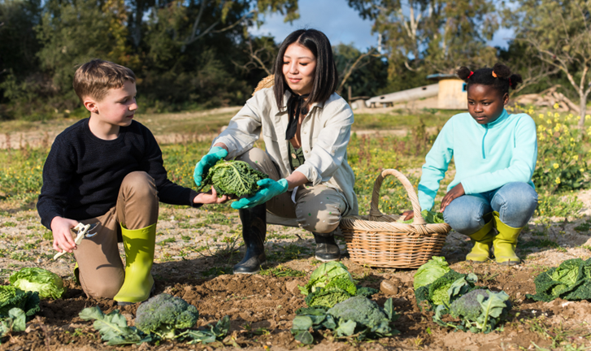
In the Classroom (cont'd)
Teach using food exploration, experiential learning and building skills You’re the Chef (YTC) is a classroom program designed for students in grades 5-8 to teach students about cooking and food handling skills. Public health offers on-line training for school staff and volunteers who would like to become a YTC leader.
Consider stage of cognitive development
Use evidence-based resources and teaching materials
Use neutral language
Notes:
When teaching about food, teachers can inspire curiosity through experiential learning and food exploration. This could be through reading about food, describing food based on colour, shape, smell, flavour and texture or participating in opportunities to grow, prepare and cook foods. These activities help students build confidence while learning important life skills.
In older grades, students can explore the food system, where and how food is grown, how foods are processed and where they are purchased. Students can explore how people access food, and how the agricultural industry impacts our economy.
When teaching about food, consider students' cognitive developmental stage when planning educational activities.
Younger children are concrete thinkers, and it is not until they are about 12 years old that they start to understand abstract concepts like nutrients in food. When applied to food and nutrition education, more concrete, hands-on strategies, like food exploration should be used before teaching about abstract concepts like discussing nutrients in food. This theory suggests that speaking about foods rather than nutrients is important when working with children under 12 years old.
For youth aged 12 years and up, a transition to discussing nutrients in a factual, non-judgmental way would be appropriate, as they are more developmentally ready to learn about abstract concepts.
Teachers can choose to use the examples and prompts that work for their classroom that are consistent with neutral language. Or, they may develop their own approaches to ensure that the healthy eating curriculum is taught in a neutral way.
And like we previously discussed, use neutral language when talking about food.

Slide 16
In the School
Ensure students have enough time to eat
Limit distractions (e.g., screens) during meal and snack times to help students focus on eating
Provide eating environments where students can eat together
Talk about all foods with respect and curiosity to help create an inclusive eating environment
Consider having a Student Nutrition Program or Emergency Lunch Program, so students can access food throughout the school day
If schools are providing food, offerings should be in accordance with the school nutrition policies
Notes:
The broader school environment also has an important role when it comes to creating positive eating environments.
This includes:
Ensuring students have enough time to eat.
Limiting student distractions, such as screens during meal and snack times to help them focus on eating.
Having eating environments where students can eat together and connect with others.
Talking about all foods with respect and curiosity as this can help create an inclusive eating environment.
Having a student nutrition program or emergency lunch program so students can access food throughout the school day.
If schools are providing food, offerings should be in accordance with the school nutrition policies, such as PPM 150 or the Student Nutrition Guidelines.

Slide 17
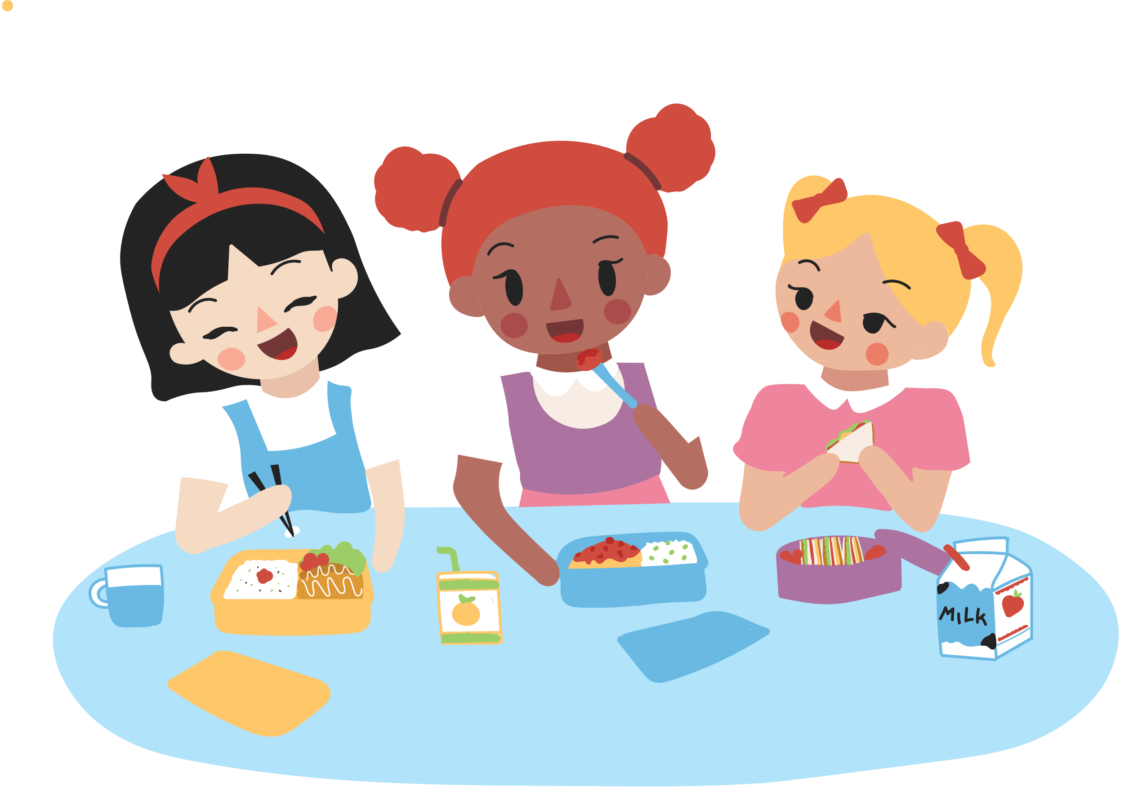
In the School (cont'd)
Build trust with students and families by
Respecting the many factors that influence what foods families provide
Allowing students to eat all items sent from home
Considering the diversity of the students and the types of foods offered when planning school food events.
Referring families to reliable nutrition info: Call 811 or chat online @ https://health811.ontario.ca/static/guest/home
Notes:
Schools can also help build trust with students and families by:
Respecting the many factors that influence what foods are provided;
Allowing students to eat the items brought in their lunch;
Considering the diversity of the students and types of foods offered when planning school food events; and
Referring families to reliable nutrition information.

Slide 18
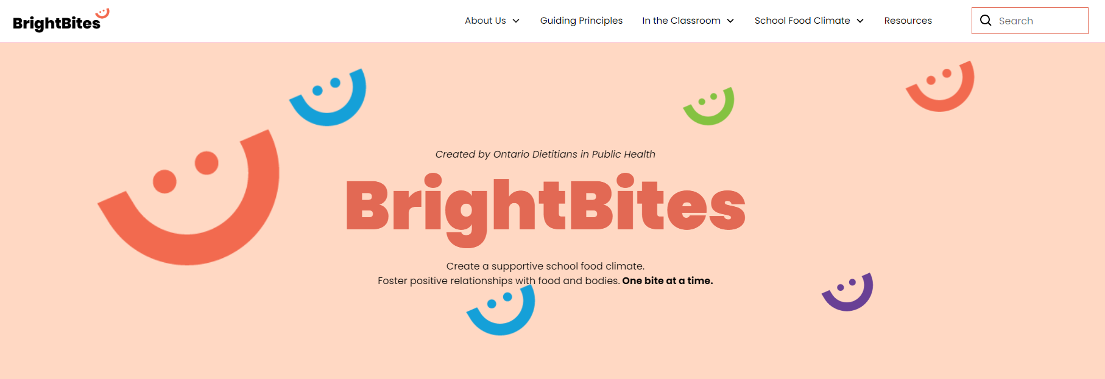

Bright Bites
Notes:
Brightbites is a website for educators developed by Ontario Dietitians in Public Health that provides information about food and health.
Educators can use the website resources to create teaching and learning environments that are aligned with some of the concepts we discussed today.

Slide 19
Thank you!
For more information contact:
519-352-7270
www.ckphu.com
519-383-8331
www.lambtonpublichealth.ca
Notes:
This concludes our Teaching Food and Nutrition in the Classroom presentation. Thank you for your participation in this learning.
We hope that we have provided you with valuable insights and practical strategies for delivering food and nutrition education to children and youth.
By adopting these approaches, we aim to help schools create nutrition environments that enhance learning and overall well-being.
If you have any questions about the material, please feel free to contact us.

